Slide 1




Exploring Computer Science/Information Technology as a Career
Collaborator: Chumbaka
Target Audience: SMK Aminuddin Baki Pembimbing Rakan Sebaya

Slide 2
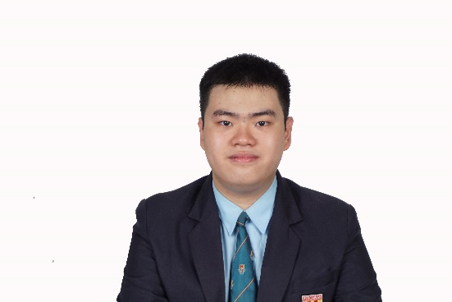
My Personal Journey to Computer Science (CS)
By: Jonathan Siew Zunxian

Slide 3



About Me
2017 - 2022
Joined the Shell NXplorers Programme from 2018 to 2020.
Participated in the MDEC Digital Ninja Programme in 2018 and 2020
Studied Computer Science as an SPM subject.
2022 - 2023
Took Jurusan Sains (Sains Fizikal)
Kolej Matrikulasi Selangor
2023 - present
Currently pursuing Bachelor of Computer Science (Artificial Intelligence)
Google Developer Students Clubs Tech (AI) Core Team Member (2023 - 2024)
Vice Head of Logistics & Technical (Technical) Persatuan Komputer Universiti Malaya (2024 – present)

Slide 4
Comparison between Shell NXplorers Programme and MDEC Digital Ninja Programme
Shell NXplorers Programme | MDEC Digital Ninja Programme
Launched in 2017 | Launched in 2017
Involving 15 schools across Sarawak, Sabah and Peninsular Malaysia | No limit of schools, recruit students from all around Malaysia - SAB students: Do not need to be part of the Shell NXplorers Programme to join this programme
The programme content is structured over three years, guided by mentors | The programme content is structured approximately six months, guided by mentors
Do not need to have an existing digital project prototype to apply for the programme | Have an existing digital project prototype to apply for the programme
End product is a digital novel solution that solves a real world problem and you will compete among your peers in a competition/hackathon Reference: https://www.shell.com.my/sustainability/communities/shell-stem-programme/about-shell-nxplorers-malaysia | End product is a digital novel solution that solves a real world problem and you will compete among your peers in a competition/hackathon Reference: https://sites.google.com/moe-dl.edu.my/digital-ninja/home?authuser=0

Slide 5
Taking Computer Science as an SPM subject
You will be learning
Form 4:
Java
Database
Human Computer Interaction (Principles)
Form 5:
Computer Ciphering and Deciphering, Technology-related Laws, Computer System and Organization – Logic Gates
Database (SQL)
Web-based Programming (HTML, CSS)

Slide 6
Personal Advice
Avoiding Biology Choose CS if you're certain you don’t want to pursue Biology or related fields (e.g., microbiology, medicine, pharmacy, dentistry).
Career Alignment: Opt for CS only if you’re confident your career path won’t involve Biology. Remember, taking CS in school doesn’t guarantee you’ll outperform peers in a CS-related degree later.
School vs. University Focus In Secondary School: CS focuses more on theory, requiring a written exam and a project. In University: CS emphasizes practical skills like solving programming problems under timed conditions (e.g., coding exams without tools like ChatGPT). Flowcharts and pseudocode won’t contribute much to your final grades.
Flexibility in Future Studies Studying CS in school doesn’t lock you into a tech career. You can pivot to other fields like Engineering, Economics, or Business for higher studies.

Slide 7

Available streams in Program Matrikulasi (Updated December 2024)

Slide 8
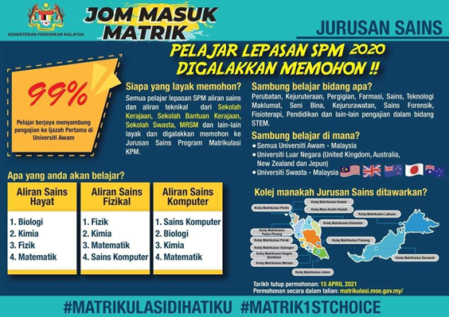
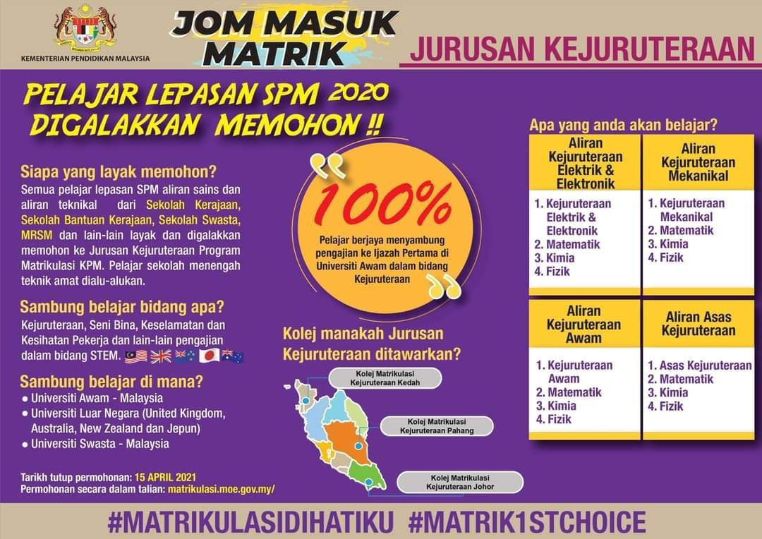
Science-based Streams in Matrikulasi Programme

Slide 9


Art-based Streams in Matrikulasi Programme

Slide 10
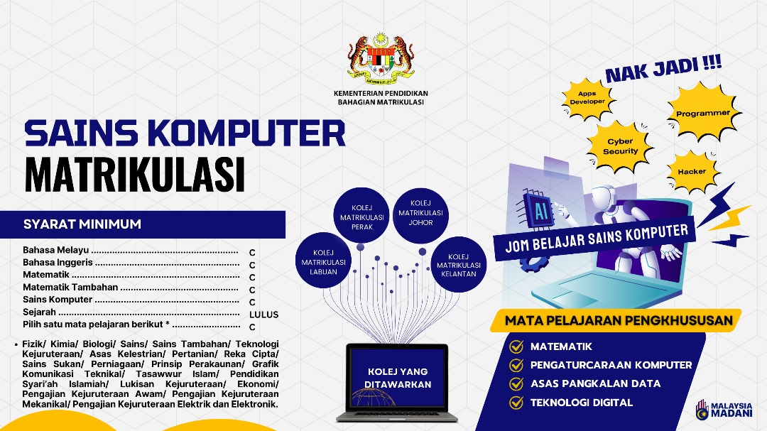
Computer Science Stream in Matrikulasi Programme

Slide 11
Personal Opinion on the CS Stream
1. A New and Evolving Stream:
The CS stream draws inspiration from the Engineering stream, offering a fresh and dynamic perspective.
2. For Passionate Learners:
If you have a genuine passion for Computer Science, this can be an excellent pathway to explore and develop your skills.
3. Flexibility in Choices:
It’s okay to discover that CS isn’t for you after a year. You can still pivot to other fields like Engineering or other disciplines that better suit your interests.
4. Resource Challenges:
Finding past year papers for this stream may be challenging, so be prepared to rely on additional resources and independent learning.

Slide 12
Personal Advice
1. Changing Streams:
Some students feel bored with Science subjects and opt for art-based streams in Matrikulasi. However, this decision may impact your UPU application as many top universities prioritize Science subjects as prerequisites for Computer Science (CS) programs.
2. Stream Selection:
Choosing Jurusan Kejuruteraan (Engineering Stream) or Jurusan Sains Hayat (Life Science Stream) will not hinder your chances of entering CS. Your attitude, commitment, and effort matter more than your prior programming background.
3. Background and Flexibility:
Even without prior programming experience, you can still excel in CS with the right mindset and work ethic.
A Science background allows for easier entry into art-related fields, whereas transitioning from non-science streams to science streams can be more challenging.

Slide 13


Available Programs in CS UM

Slide 14
Differences between BCS (AI) and BCS (DS)
BCS (AI) | BCS (DS)
More than 100 students are enrolled in this course | Only 50 Malaysian students are enrolled in this course
Tuition fees for 3.5 years is around RM10,000. | Tuition fees for 3.5 years is around RM20,000.
The courses (subjects) focus more on AI-centric areas | The courses (subjects) emphasizes data analysis and processing
Specialization electives are designed for students aiming to develop expertise in AI techniques, robotics, and intelligent systems. | Specialization electives focus on extracting insights from data, using analytical tools, and applying big data and machine learning for decision-making.
Able to mingle more with other majors for group assignments | Able to take coveted courses that other majors do not take

Slide 15
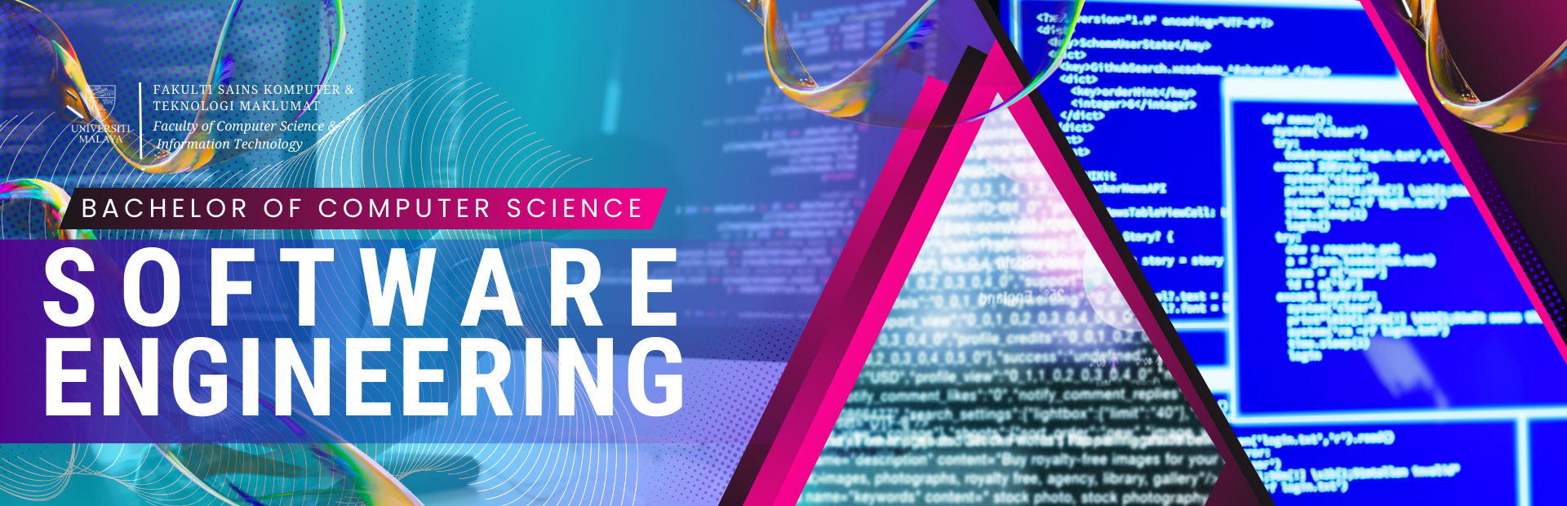

Available Programs in CS UM (Cont.)

Slide 16
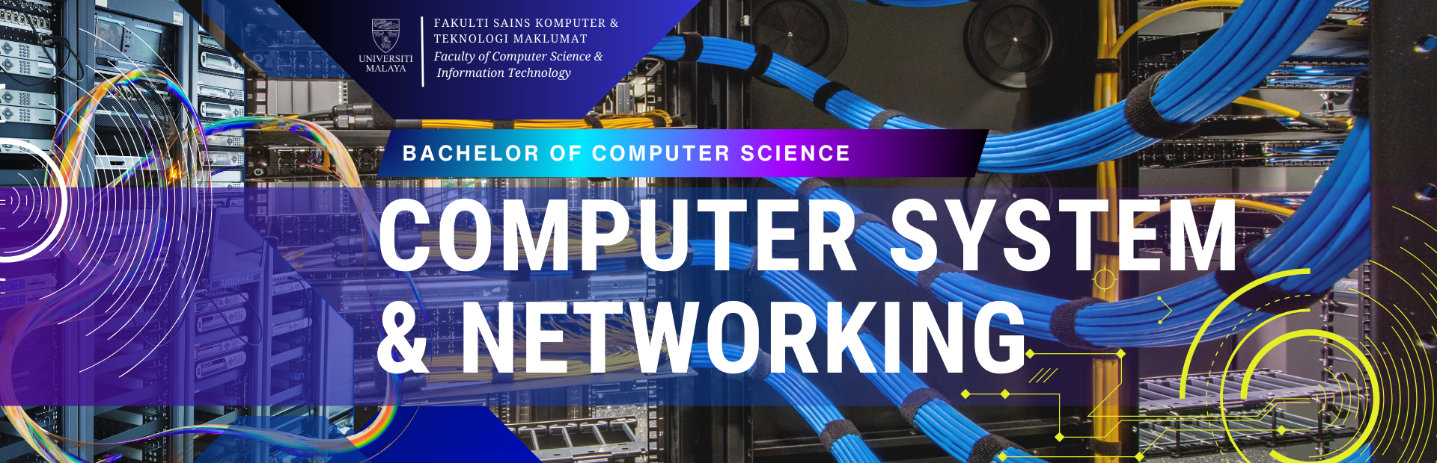

Available Programs in CS UM (Cont.)

Slide 17
The Reality of University Life at UM
Group Assignments: Expect to handle an average of 4–6 group assignments per semester within the 14-week timeframe. These assignments are an integral part of the learning experience, emphasizing teamwork and collaboration.
Diverse Community: You’ll have the chance to collaborate with students from various backgrounds and regions across Malaysia. This is a unique opportunity to observe and learn about different work ethics and cultural practices.
Team Dynamics: Be prepared to work with people exhibiting various work styles, such as:
Free riders: Those who rely on others to complete the work.
Hardworking individuals: Those who are diligent and committed.
Learning to navigate these dynamics will enhance your leadership and interpersonal skills.
Balanced Lifestyle: University isn’t just about academics. Make sure to enjoy your time on campus by engaging in extracurricular activities. For instance, participate in SUKMUM (Sukan Mahasiswa Universiti Malaya) 2024 or explore your creative side by joining the Universiti Malaya Symphony Orchestra. These experiences will enrich your university journey.

